Slide 1
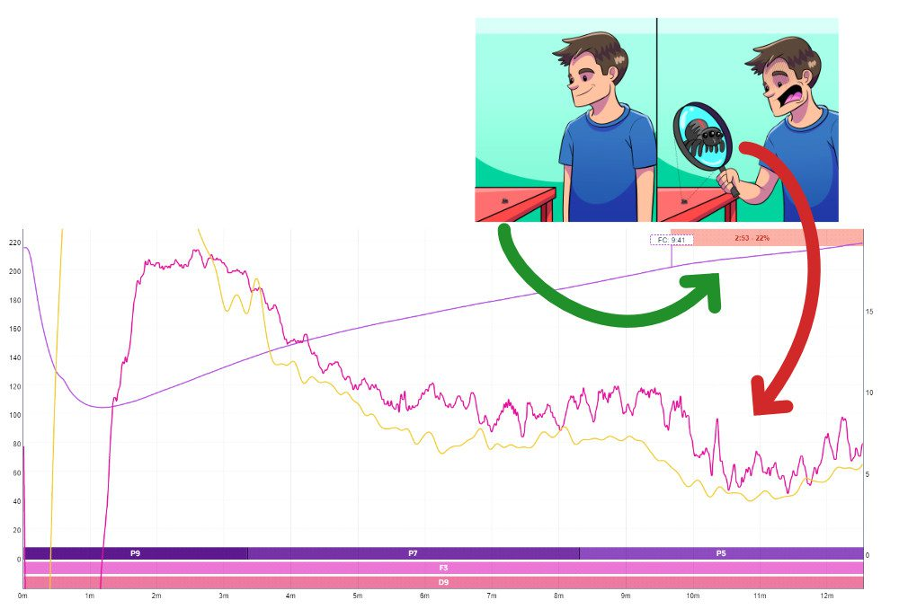
Why Rate of Rise is a bad reference point for optimizing flavour in coffee roasting

Slide 2
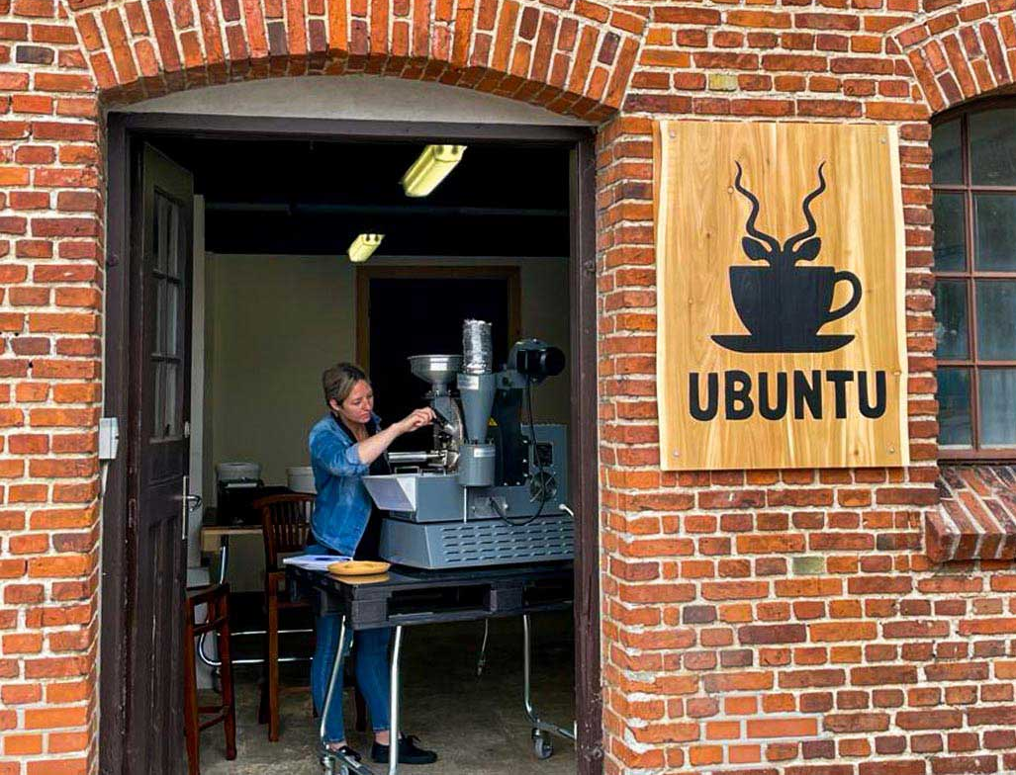
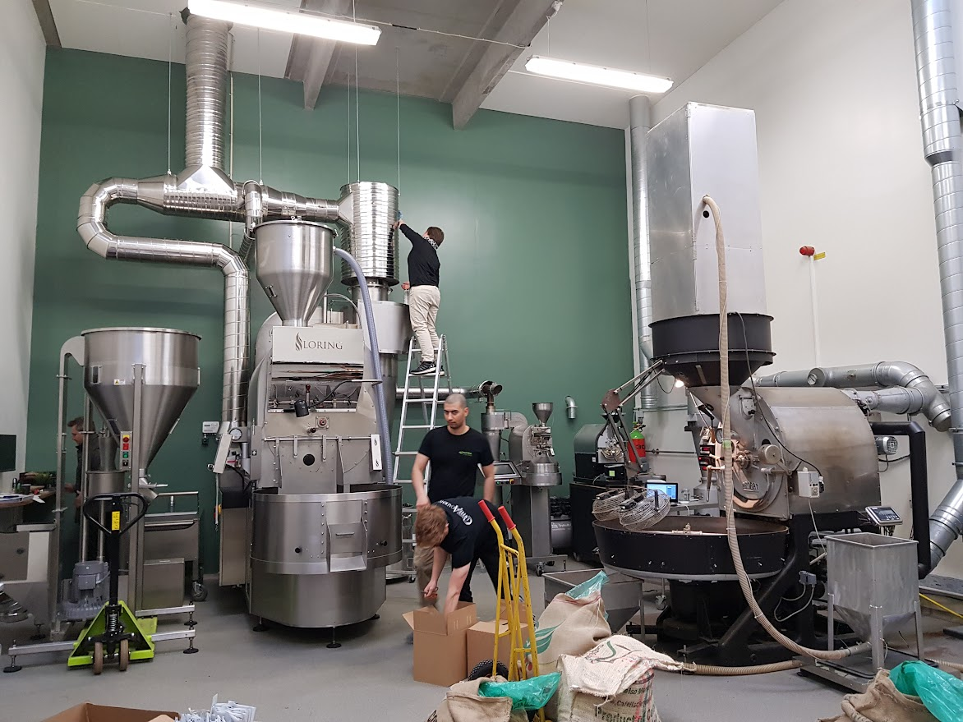
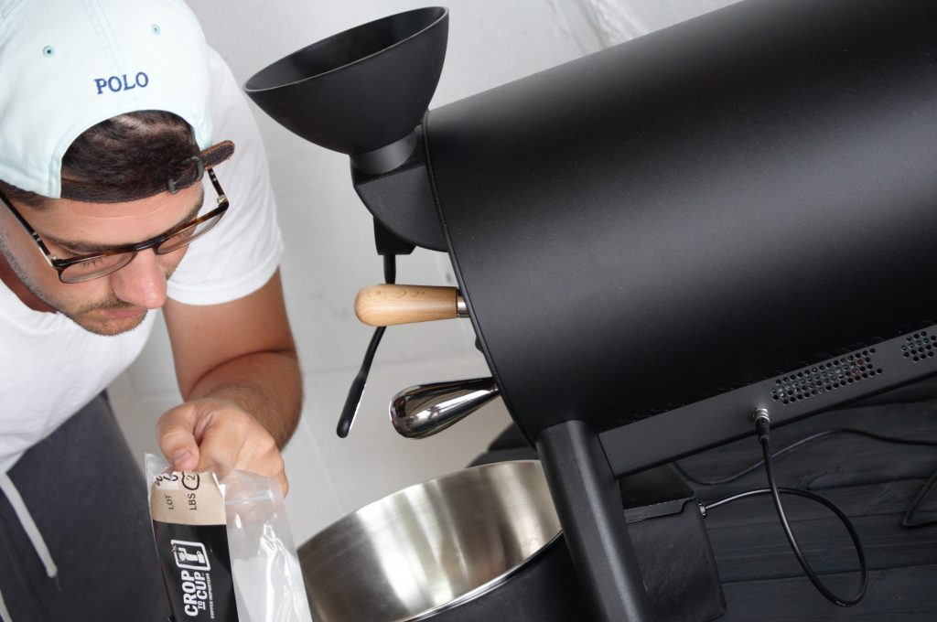
Who is this for?
Startup roasteries is our main focus
Experienced coffee roasters find the simple, clear and evidence based approach relieving
Prosumers – for whom only the best is good enough – finds our methods and theories very useful too!

Slide 3
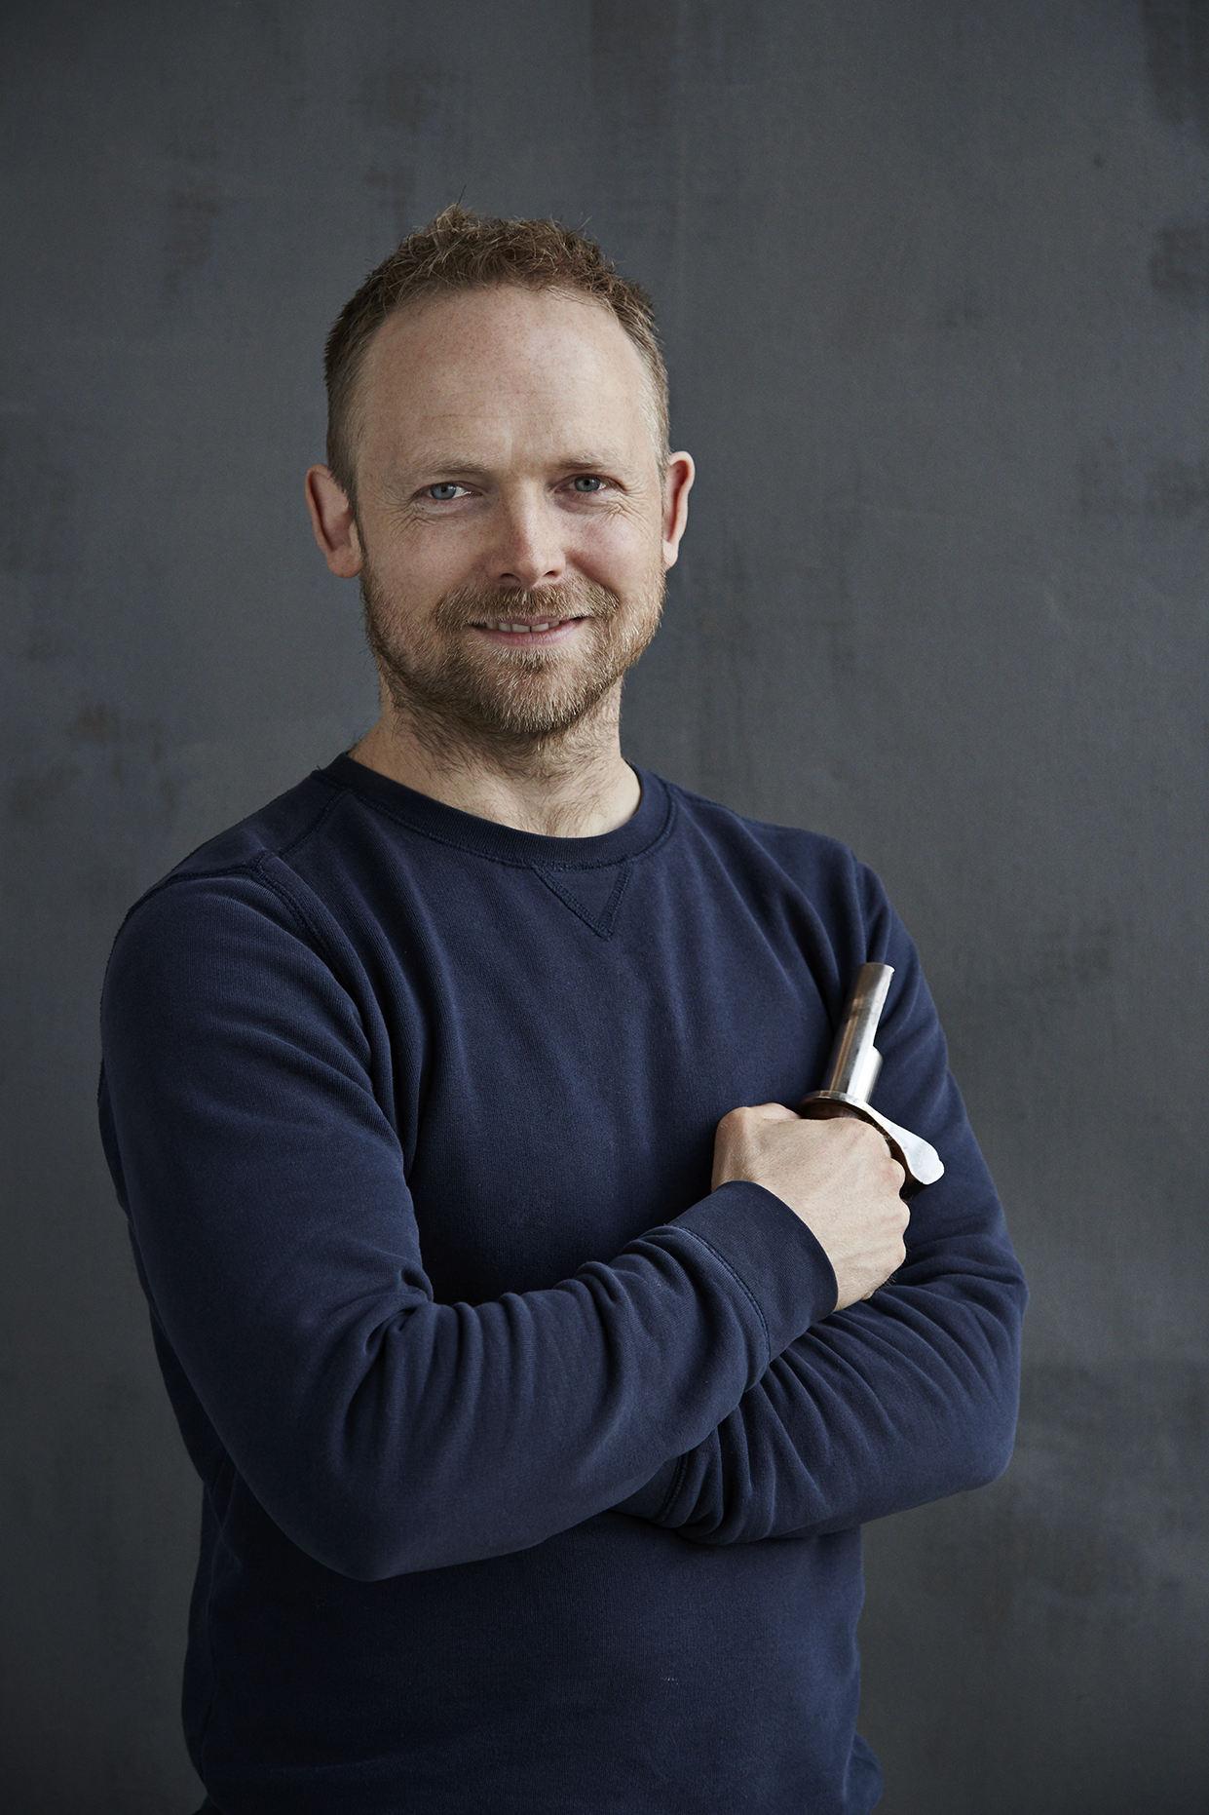
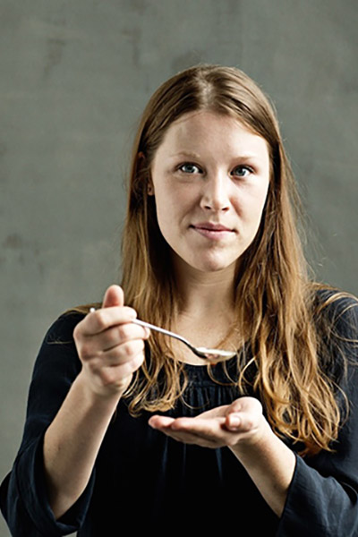
Specializing in
Coffee Roasting
and
Sensory Analysis
Through
Education,
Consultancy &
Science
Morten Münchow
Coffee Roasting
Ida Steen
Sensory Analysis

Slide 4
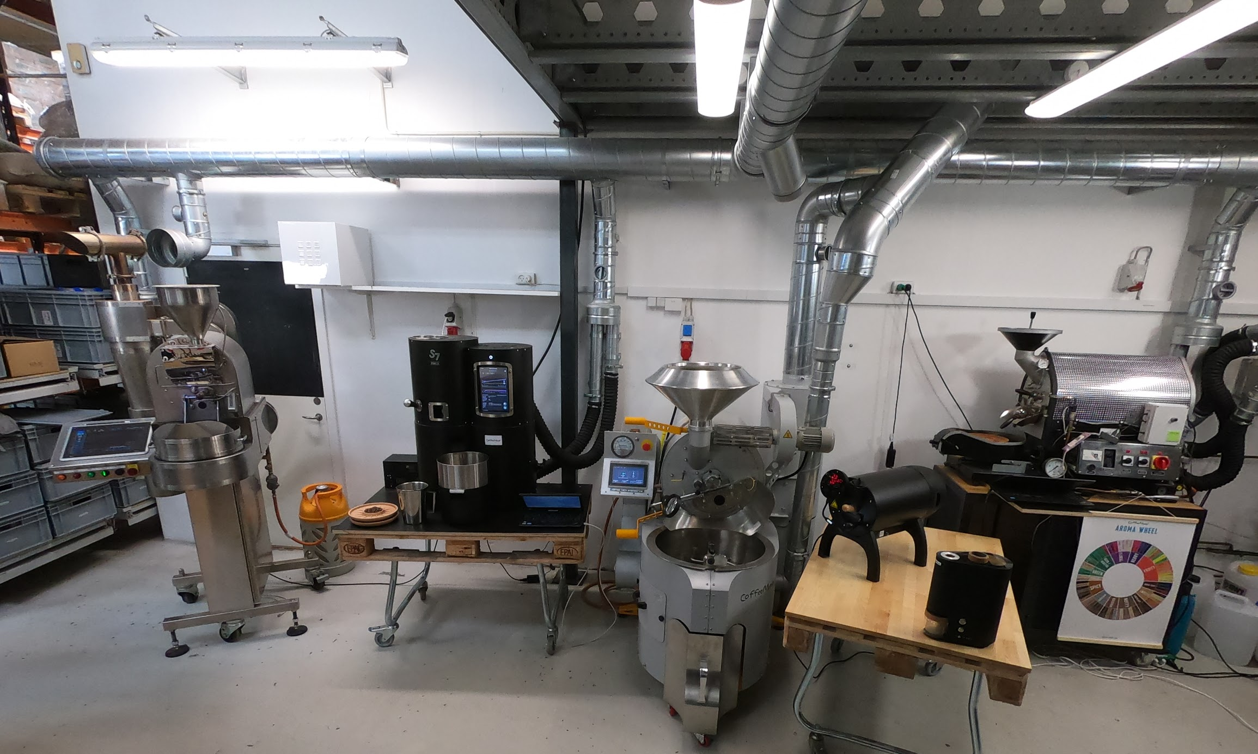
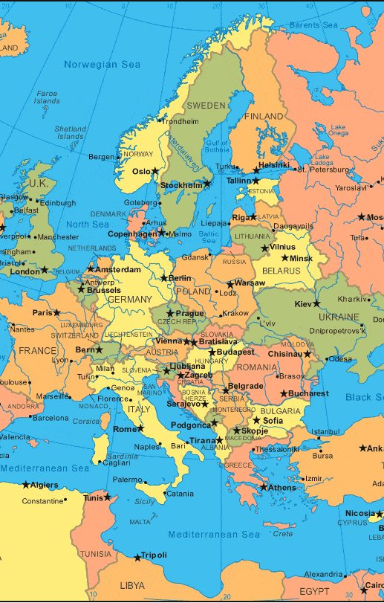
Academy
Copenhagen, Denmark

Slide 5
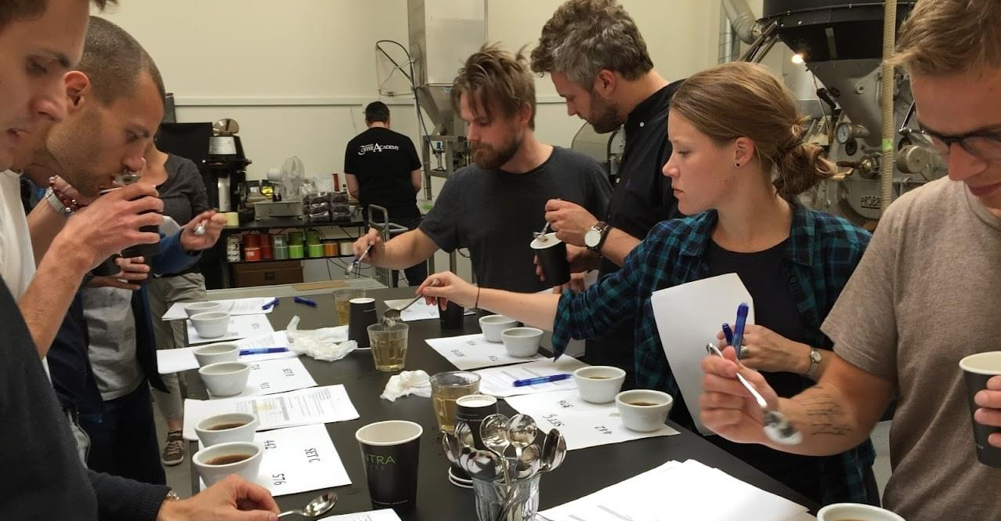
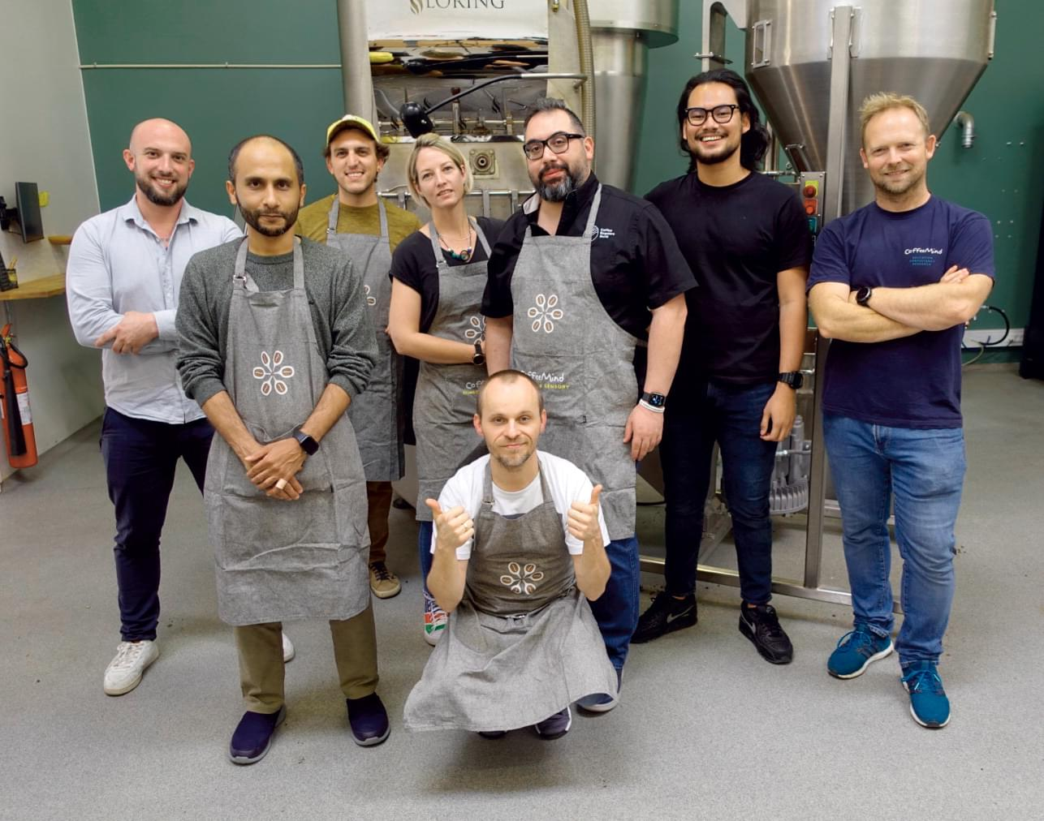
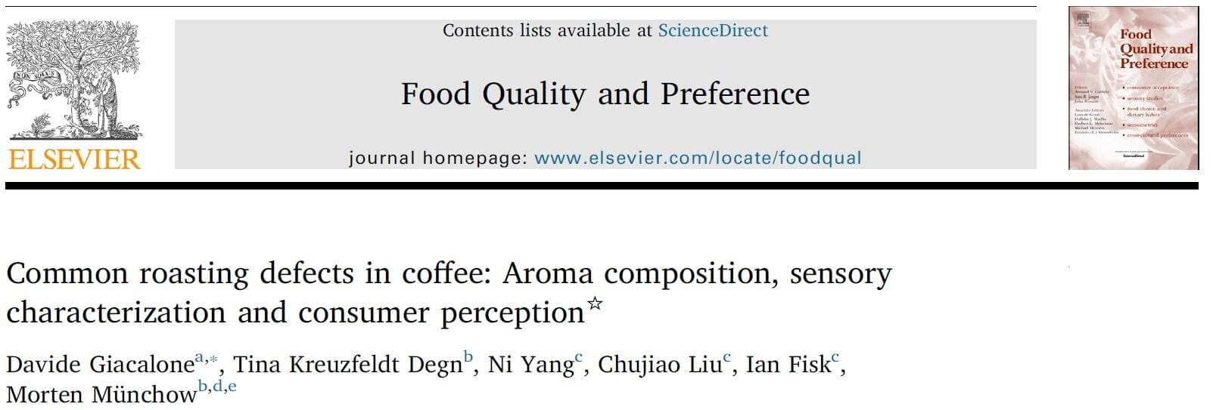
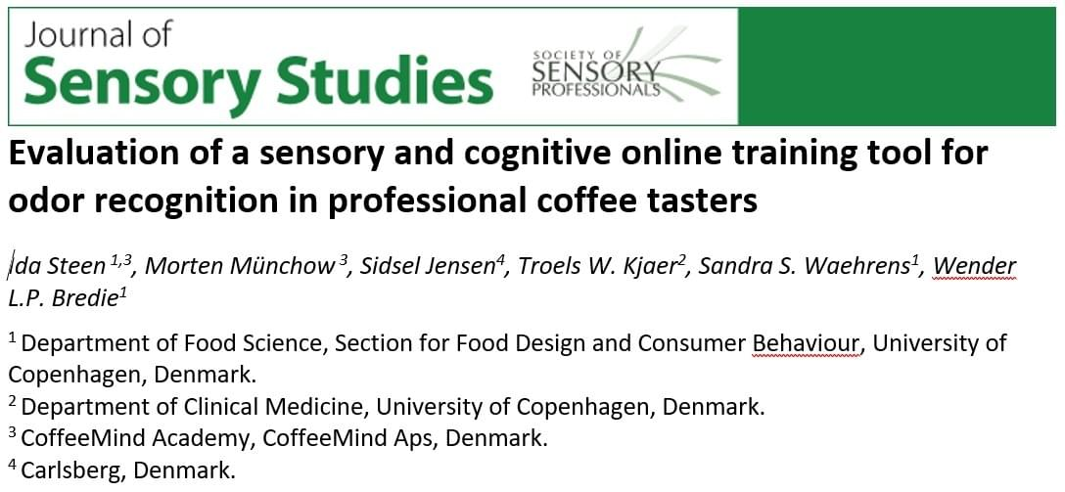
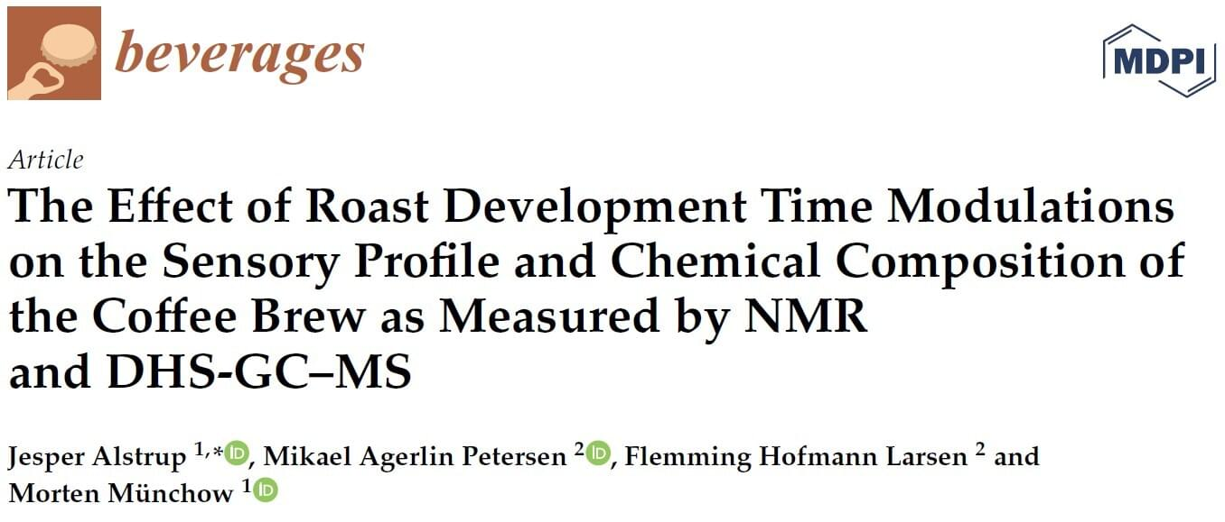
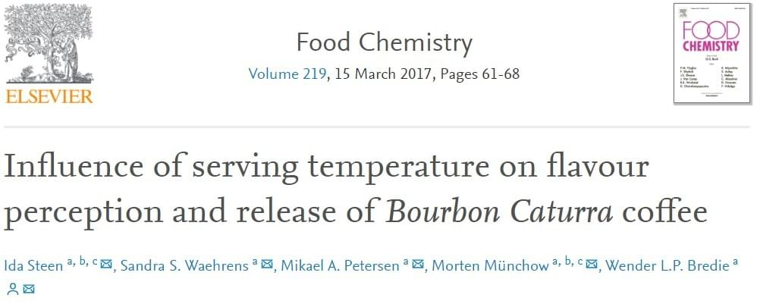
Since 2007 We have
Copenhagen 2018
Taught more than 2000 individuals coffee roasting and sensory skills since 2007
Consulted more than 30 Roasteries world wide
Initiated more than 30 scientific research projects
Published 15 scientific papers
Copenhagen 2022
South Korea 2007

Slide 6
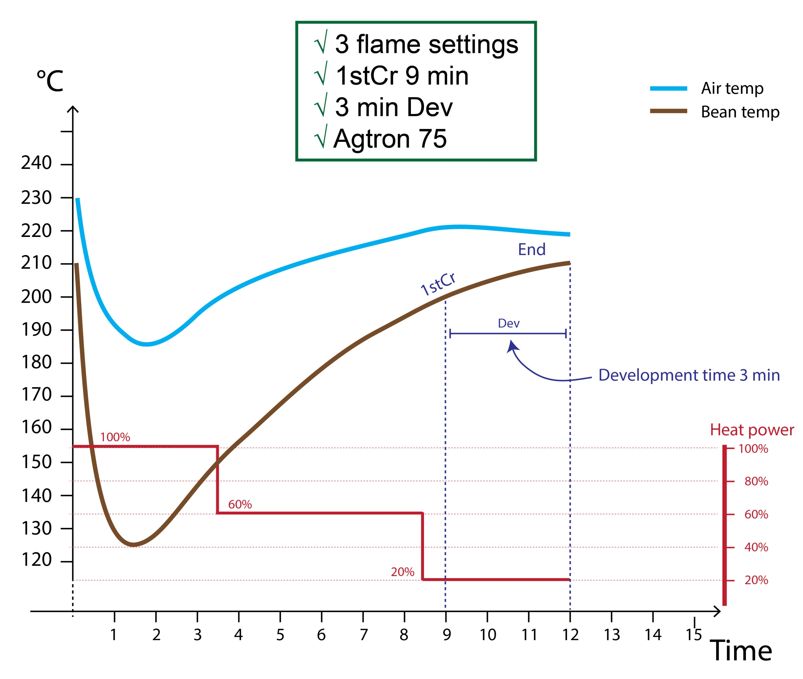
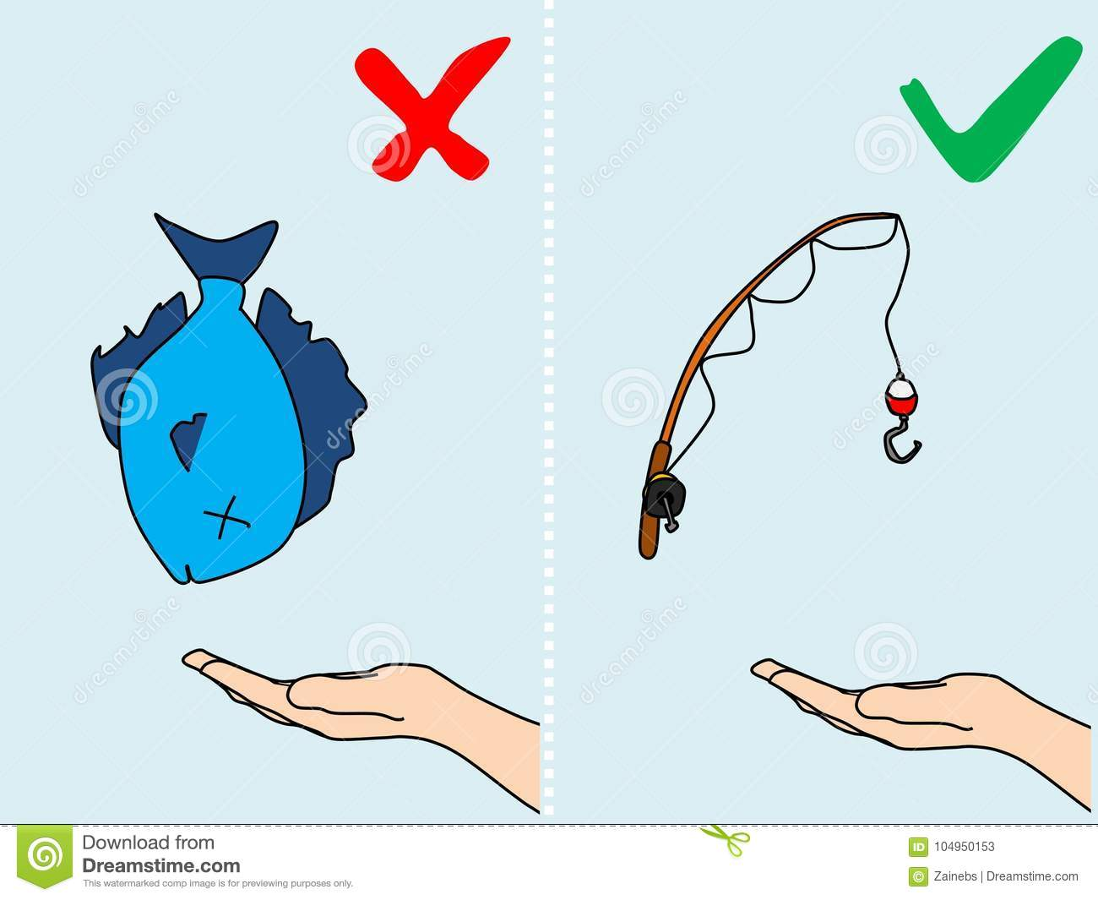
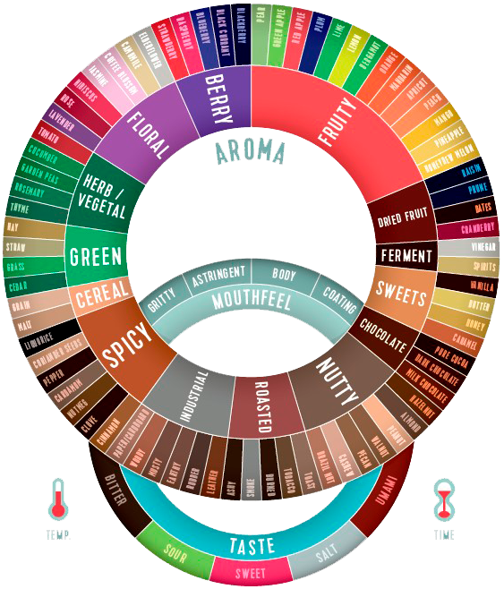
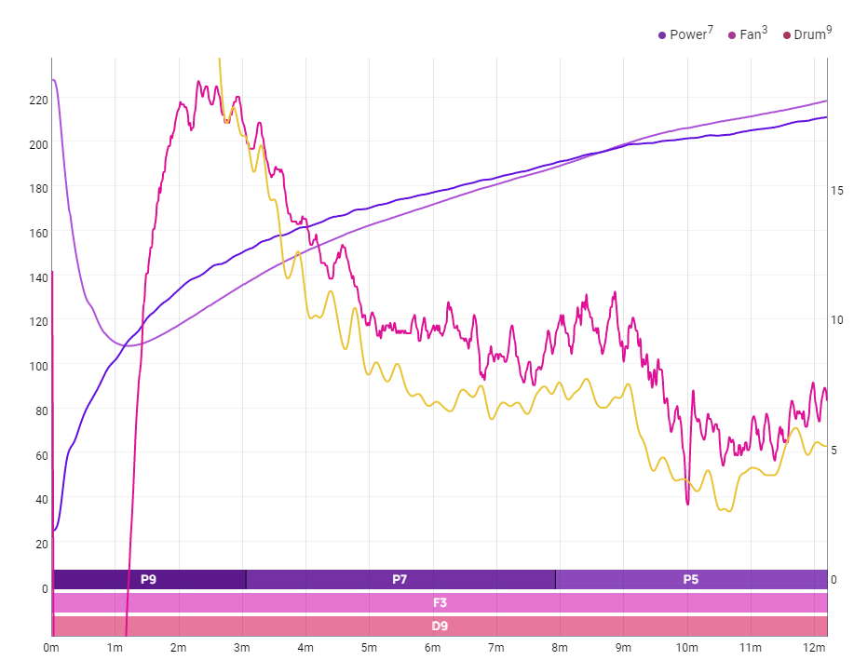
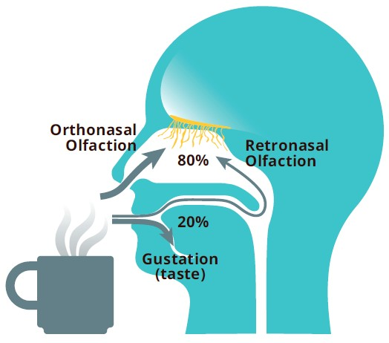
Competencies vs Copy-paste
Control + Experimentation
Self confident evaluation

Slide 7
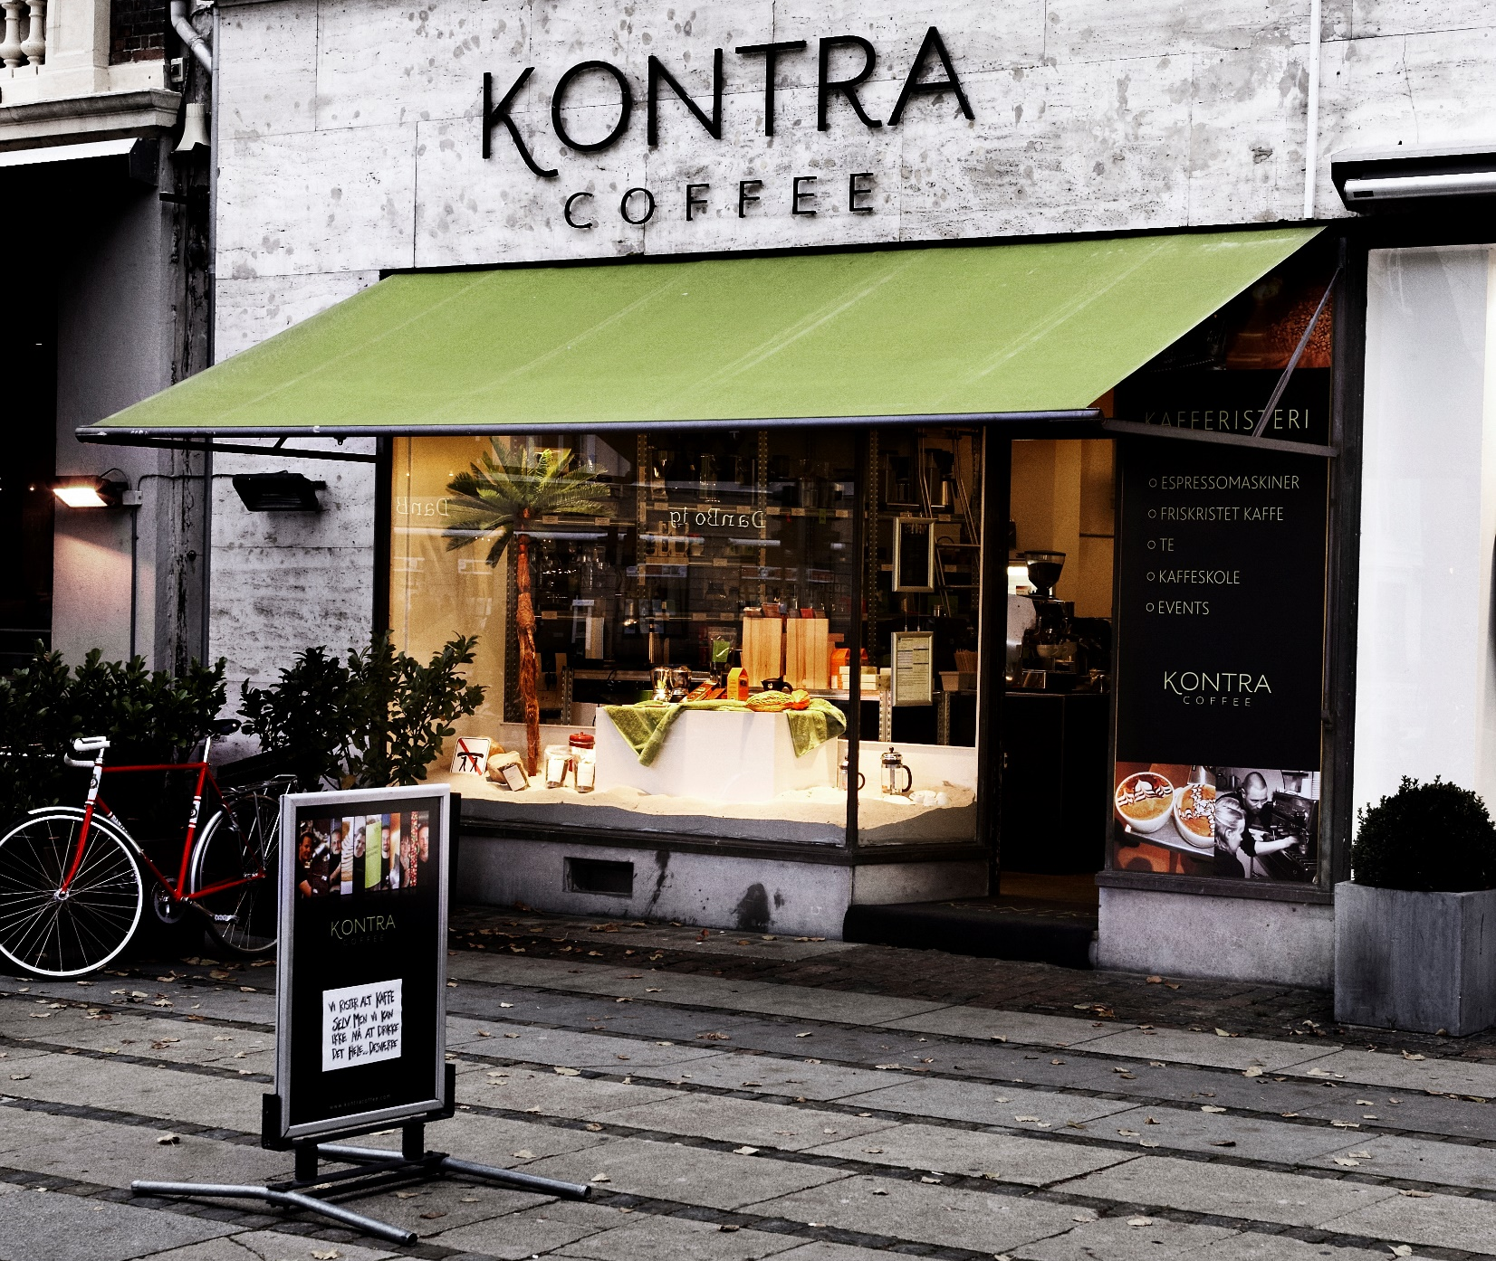
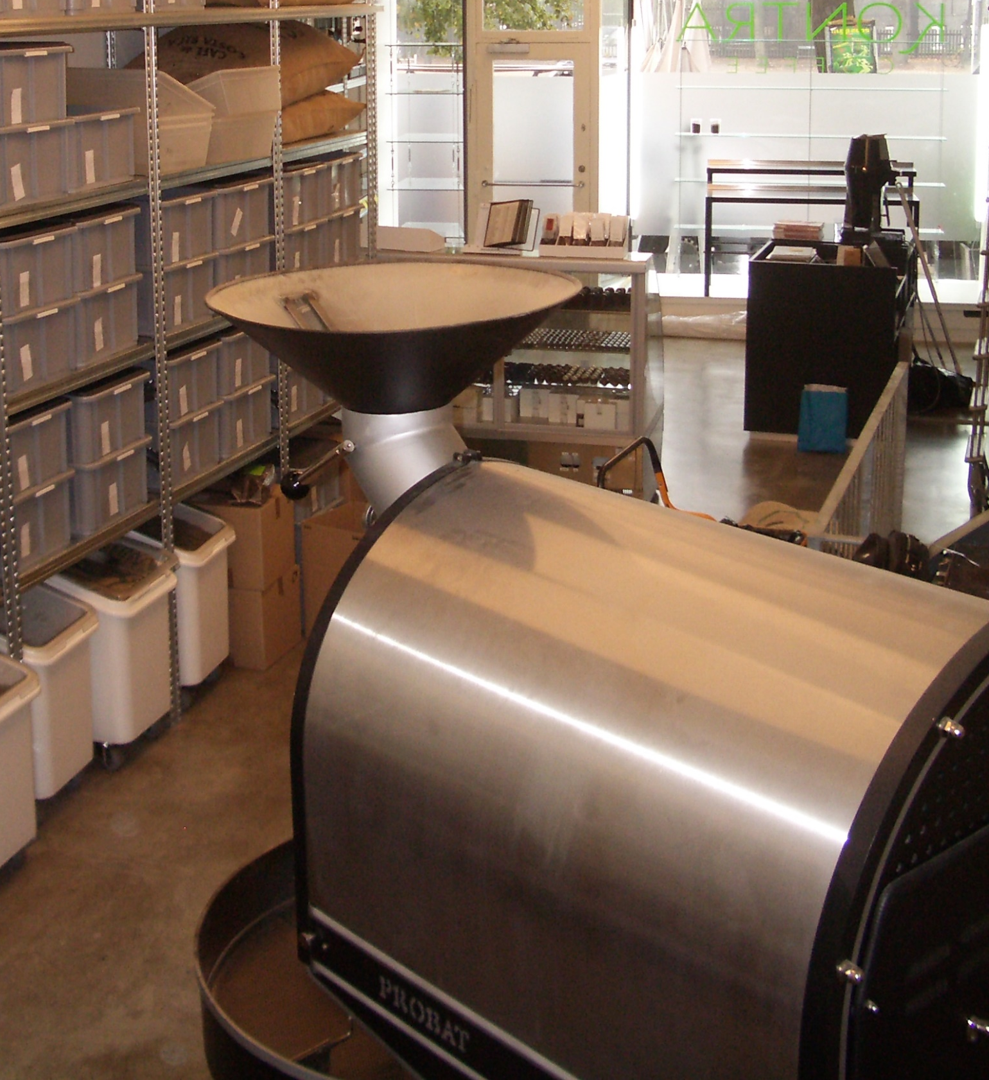
Kontra 2005
Probat L12
Thermostat -> On/Off button
Following instructions

Slide 8
Kontra 2006
?
12kg roaster
30kg roaster
Notes:
Kontra acquired a vintage hand 30kg Probat from 1962
Nobody knew how to operate it so I was pretty clueless
I was responsible and with the traction Kontra had failing to keep the customers happy was really a frightening thought
I had to really think deep and I realized that I had to just keep it simple and build on my knowledge about thermodynamics and chemical transformation.
Not specific fancy molecules but just the fact that it takes a lot of energy to boil water and that the dry state in the end needs less energy and color much me an indicator for how developed the coffee is
I had an approach and was up for it!
I pulled it off matching time before and after first crack and matching color of old products and Kontra and the customers where happy!
Two years after roasting my first bean I consulted in South Korea and with me simple approach I was quickly abot to help them out
Only after solving the challenge with the 30kg Probat myself I felt like a coffee roaster

Slide 9
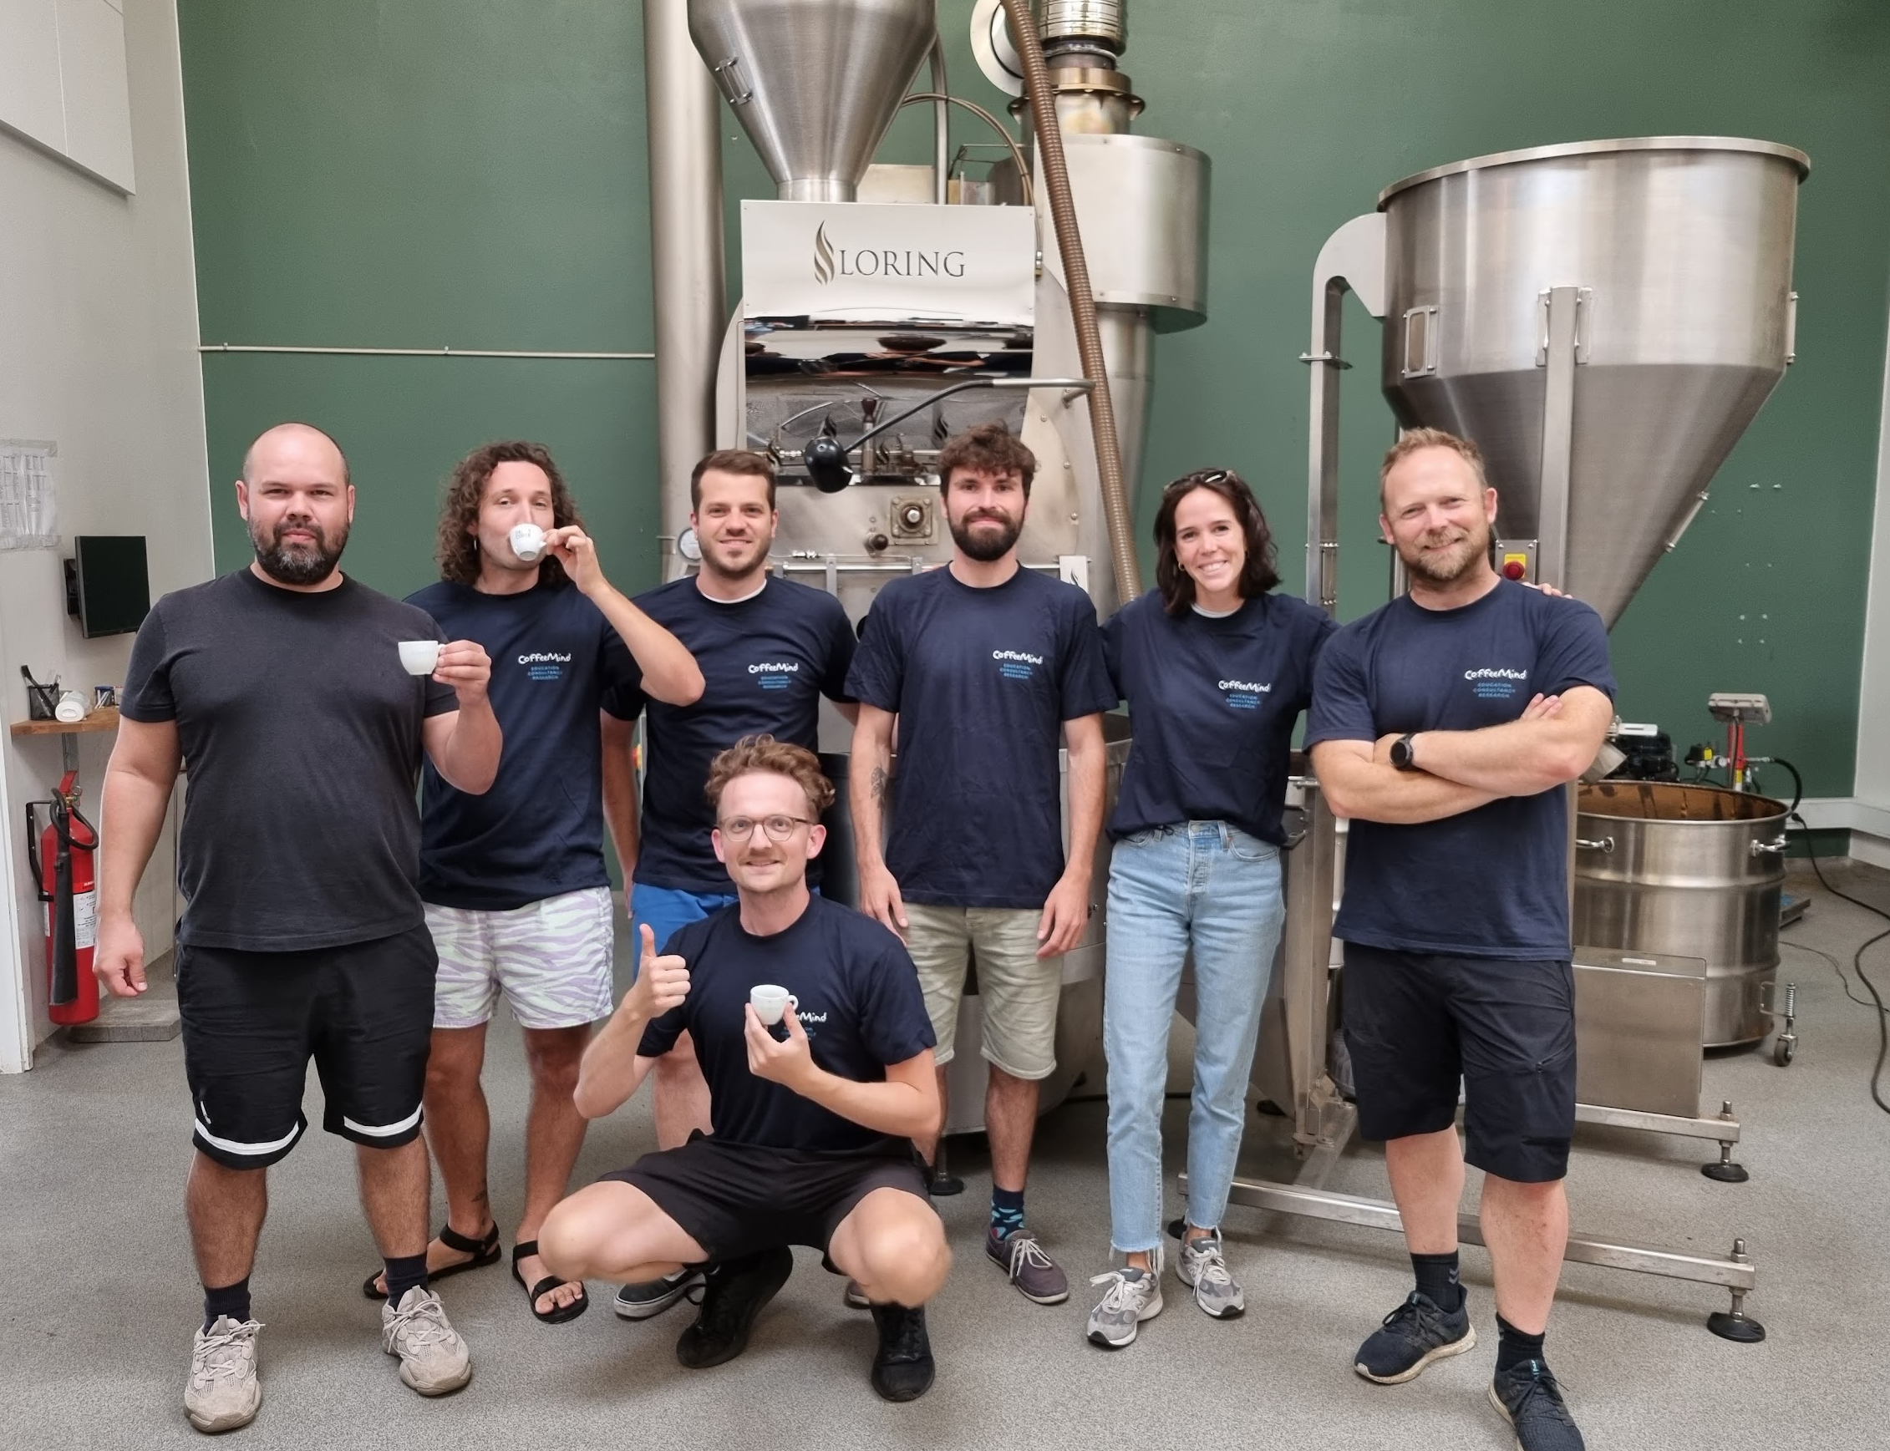
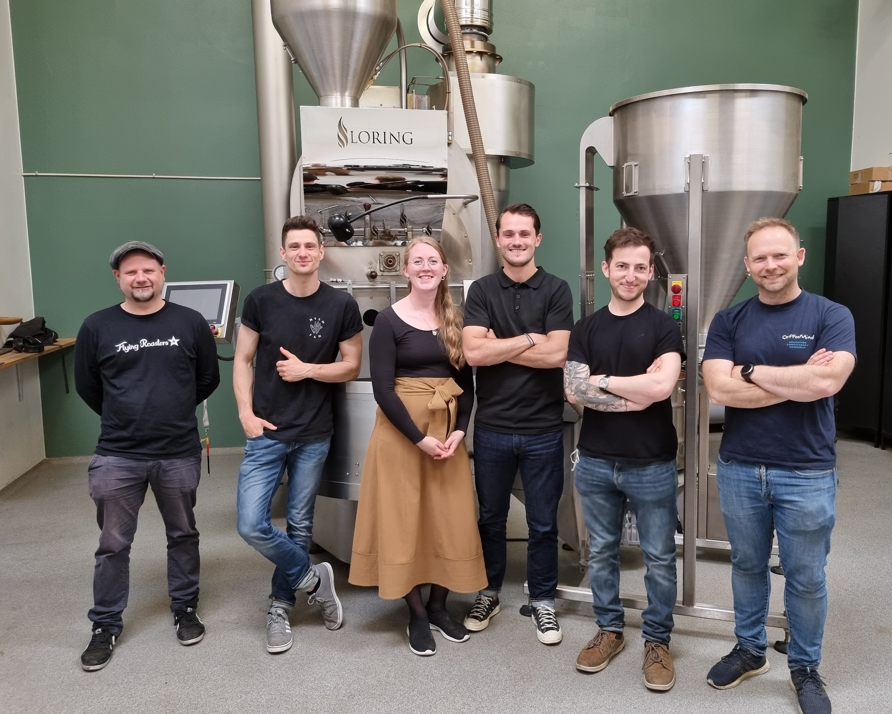
Kontra 2022

Slide 10
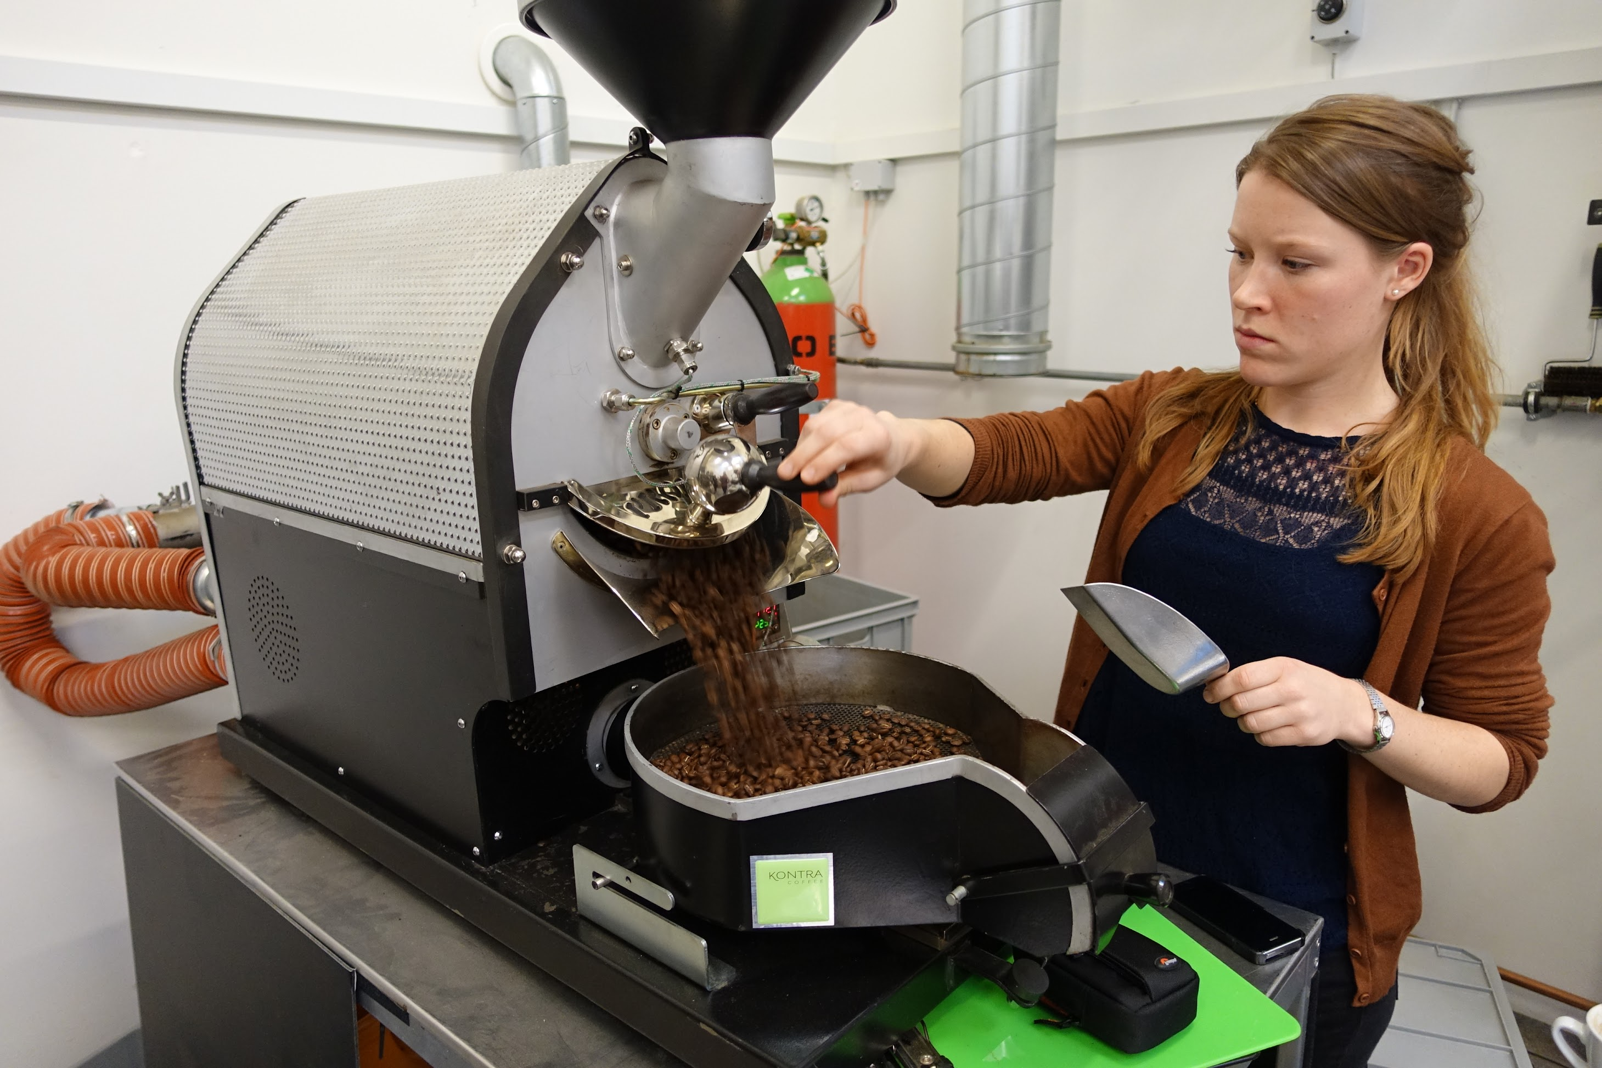
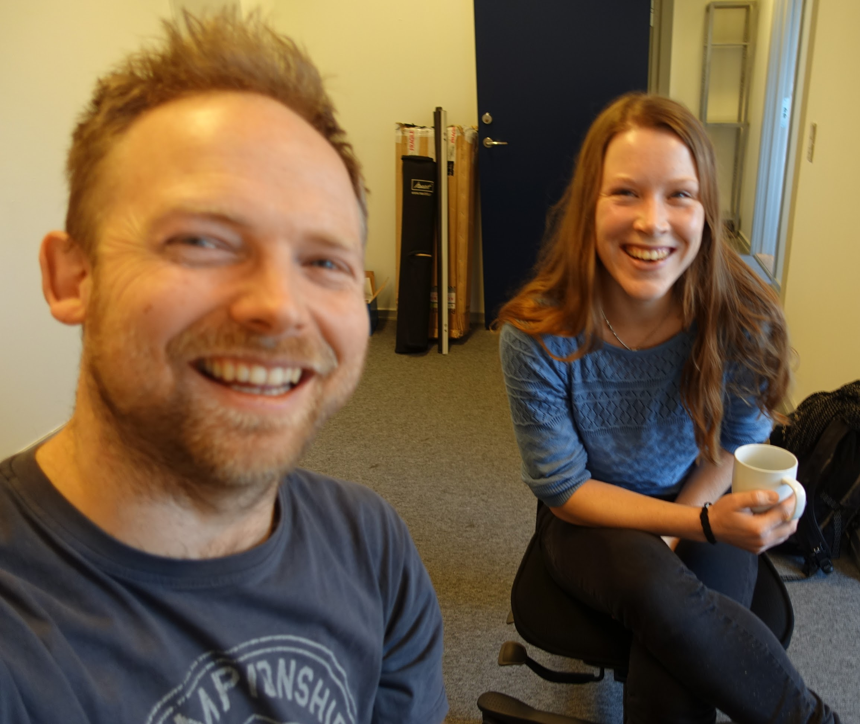
Ida Steen joins CoffeeMind in 2014

Slide 11
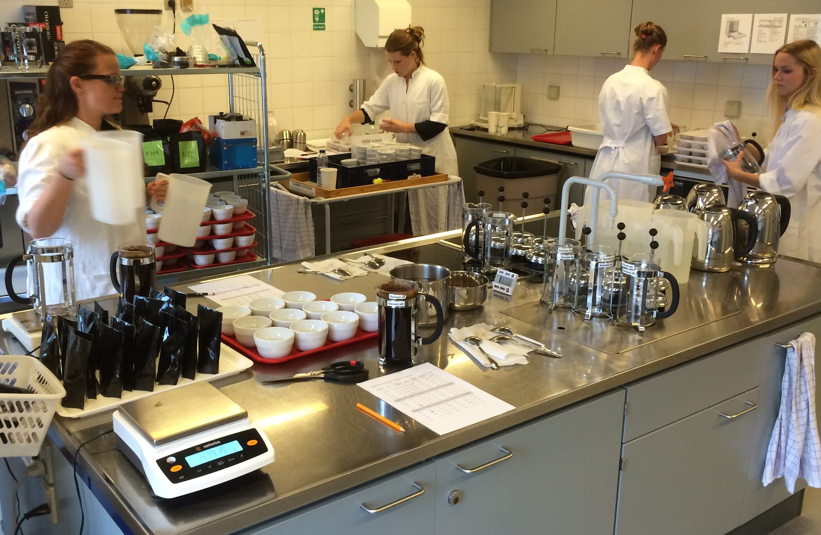
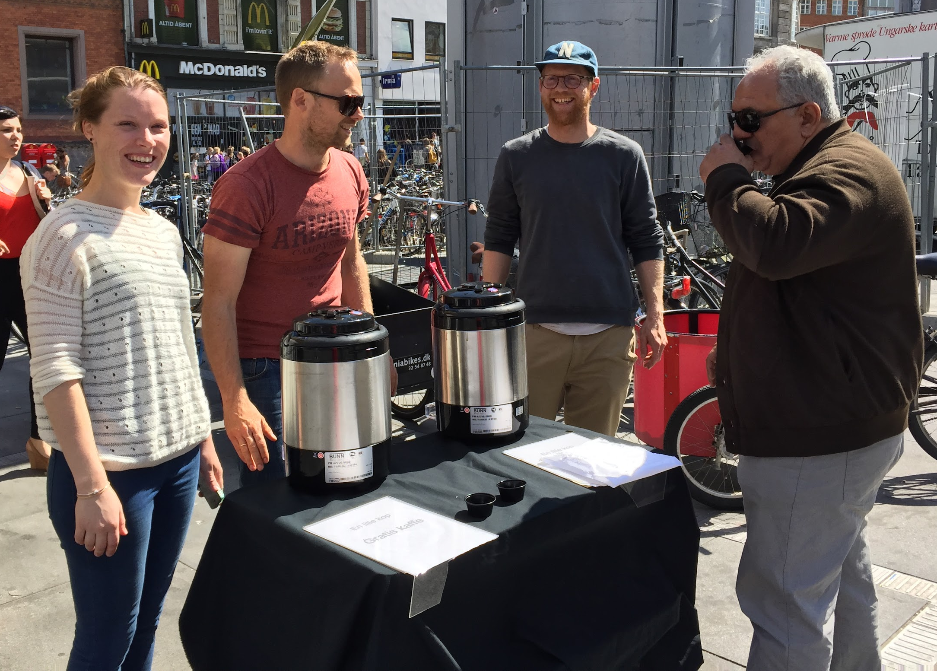
No universal quality yard stick
Small differences are not relevant
Laboratory analysis: DESCRIPTIVE
Consumer testing: PREFERENCES
Notes:
After reading all the ‘How to do this and that’ it was refreshing to learn that in science you destinguish between DESCRIPTOIN and PREFERENCE
Don’t chase the GOD SHOT because different people have different preferences
And often small obsessive aspects are not percieveable
Many of my claims as a roasting teacher where not true or too small to be relevant!

Slide 12
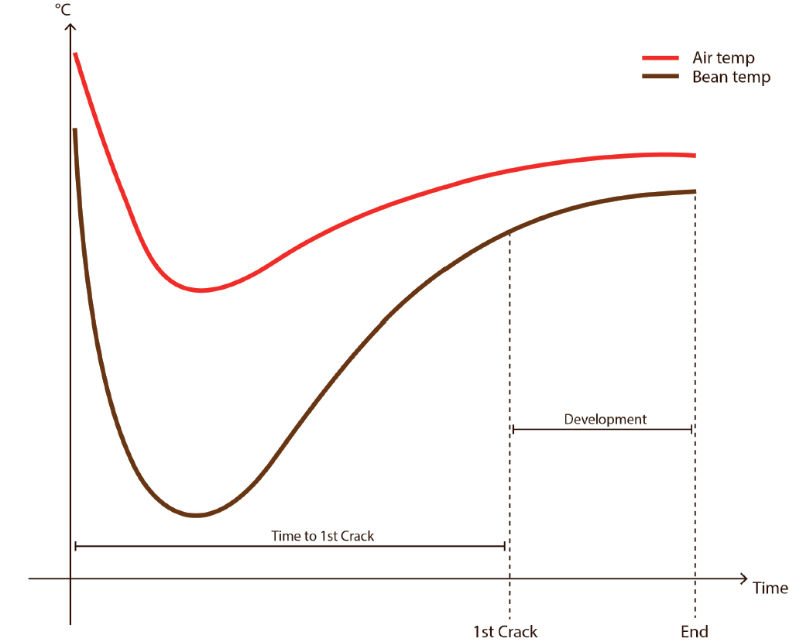
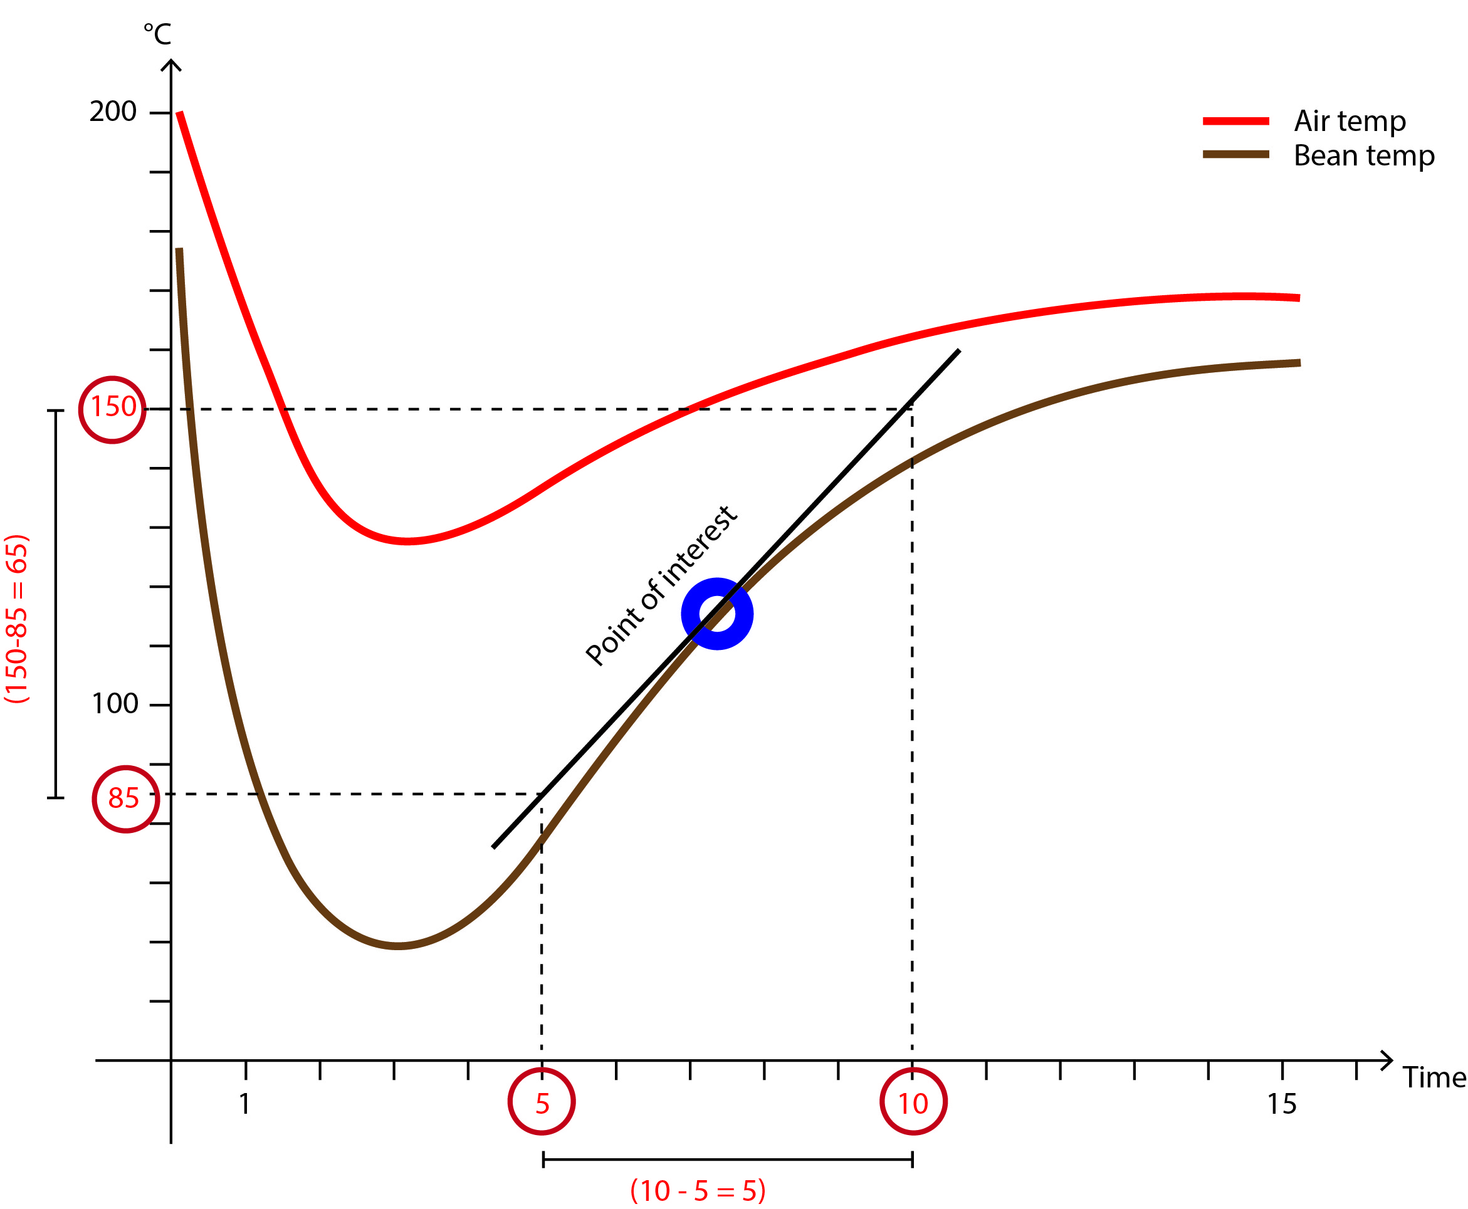
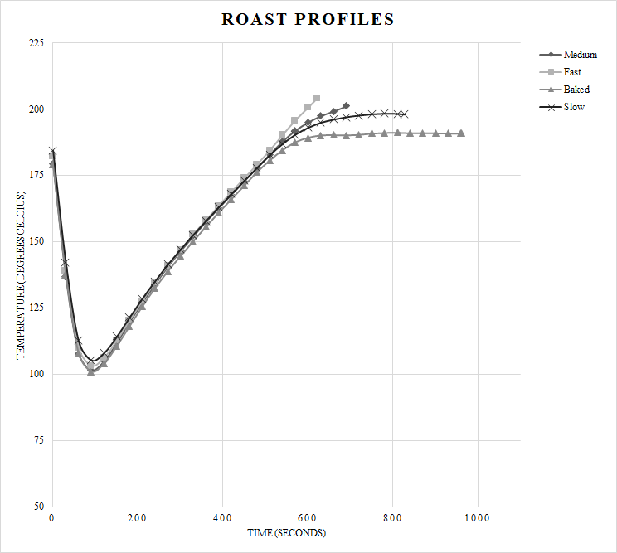
Roast profile parameter priorities from our research
What can you do with the Rate of Rise?
- Predict the future
COL 80%
DEV 15%
1st 5%
- Categorize roast with average RoR after 1st crack
Fruity
All these roast are
the same colour !!
Chocolaty

Slide 13
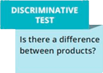
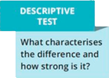
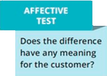
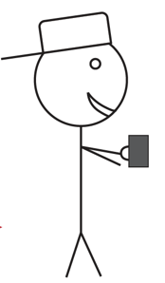
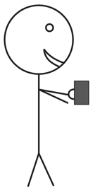
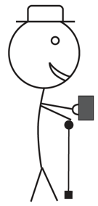
Light
Liking
Intensity
Light
Med
Dark
Med
A
B
C
Acidity
Bitternes
P < 0,05
Liking
Acidity
Bitternes
Light
Med
Dark
Bitternes
Acidity
Dark
Light
Med
Dark
Liking
Light
Med
Dark

Slide 14
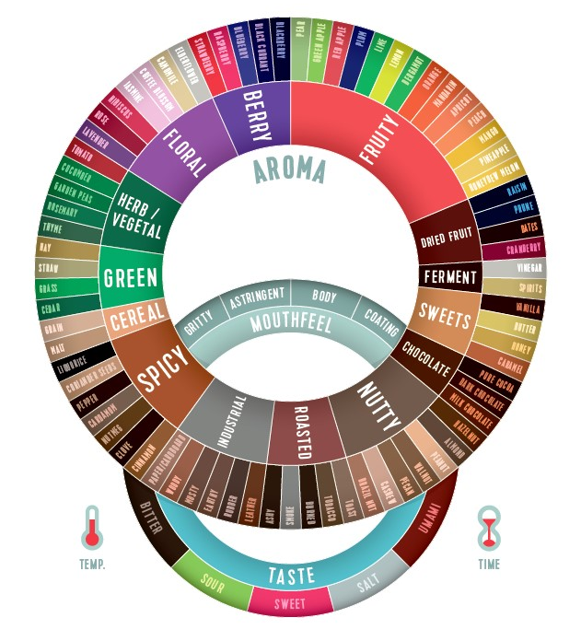
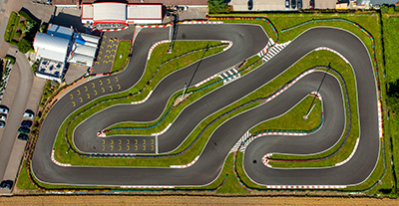
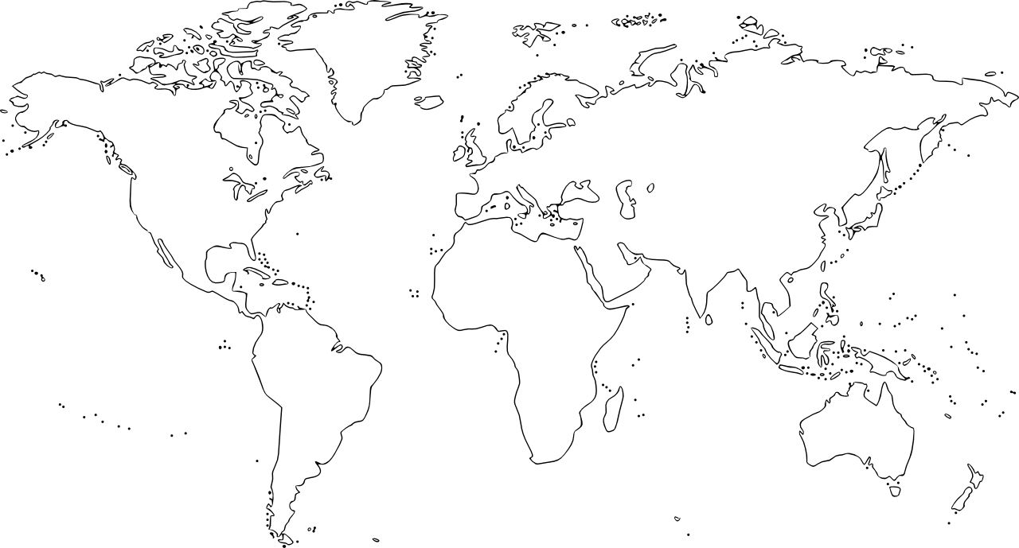
The structure of a good roasting education system
Control ”How fast is the roaster?” Focus: The Machine | Flavour Experimentation ”How can this coffee taste?” Focus: The Coffee | Flavour objective ”What is preferred by Whom?” Focus: The Customer
The standard roast
Learning how to drive the car | Explore the whole world by car | Going a specific route

Slide 15
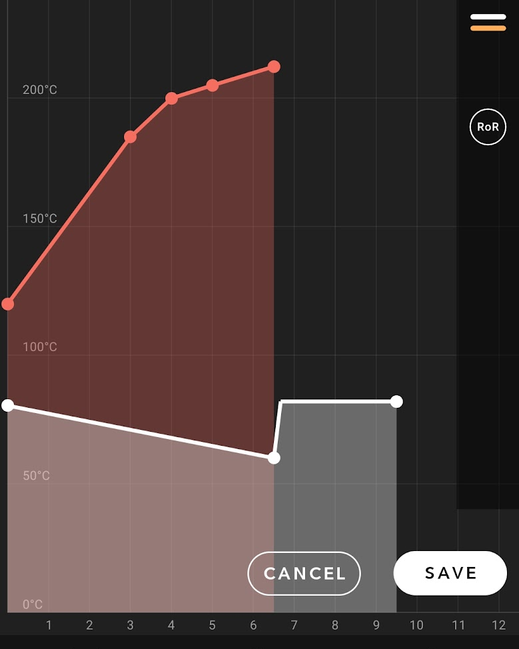
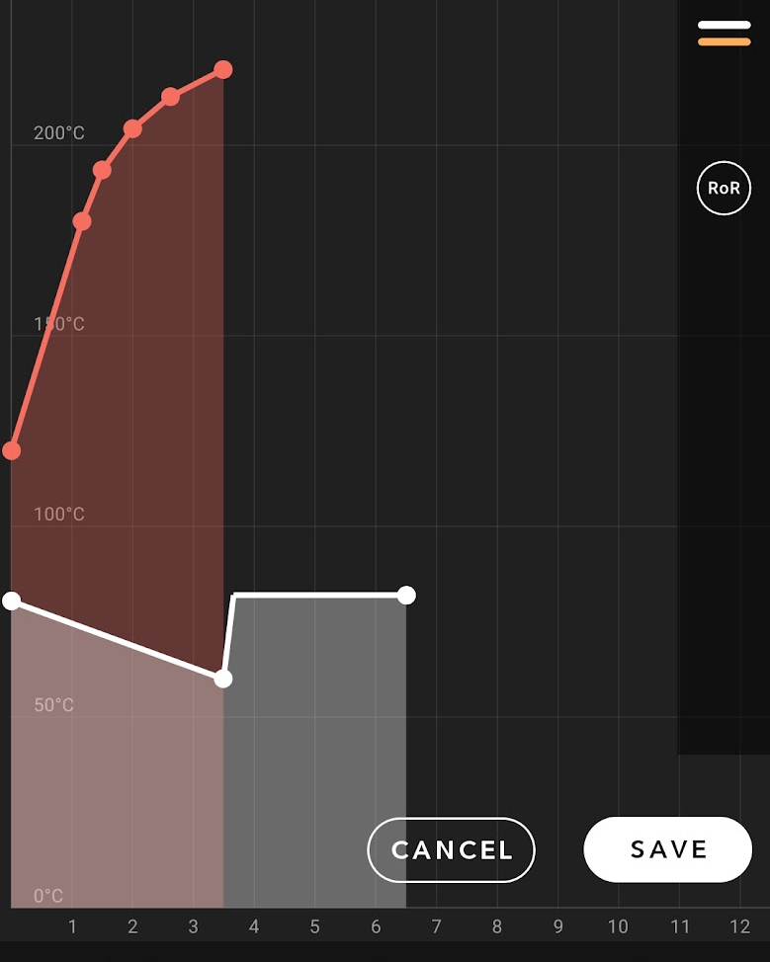
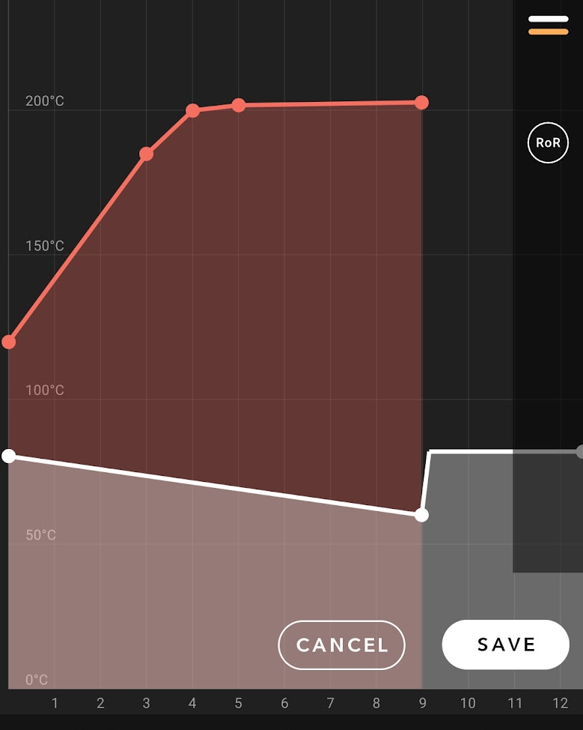
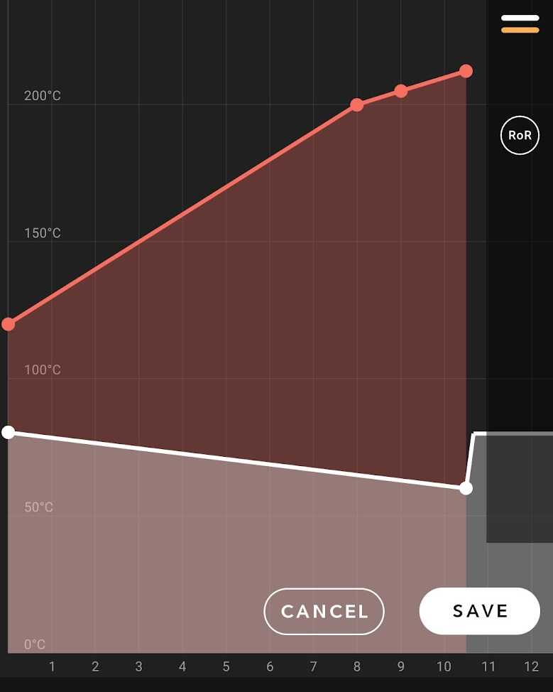
Ref
Ref
Ref
Scorched
Baked
Underdev
(Ref – 3 min)
(Ref + 2,5 min dev)
(Ref + 4 min to 1stCr)

Slide 16
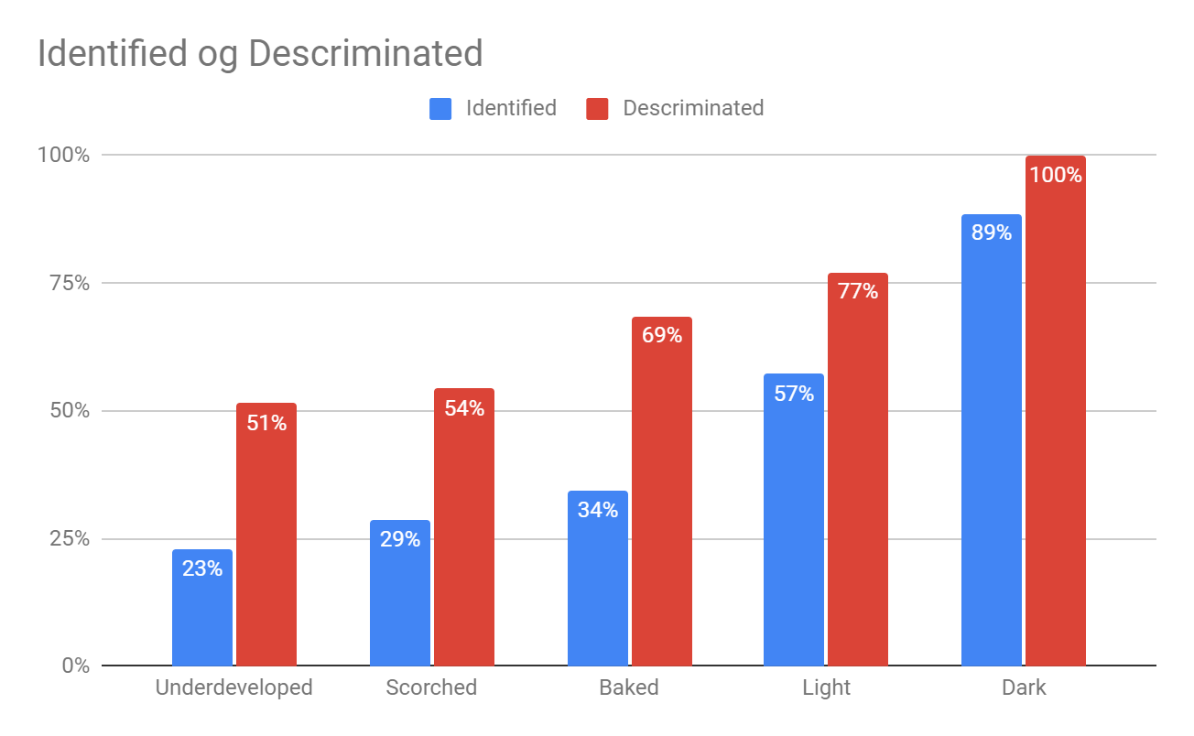
A
B
C
46%
31%
?
Scorched
Baked
Underdeveloped
Light
Dark
49%
77%
71%
66%
33%
(Ref + 4 min to 1stCr)
(Ref – 3 min)
(Ref + 2,5 min dev)

Slide 18
Chain of causality (first principles)
We already have the RoR data = curve shape we already see

Slide 19
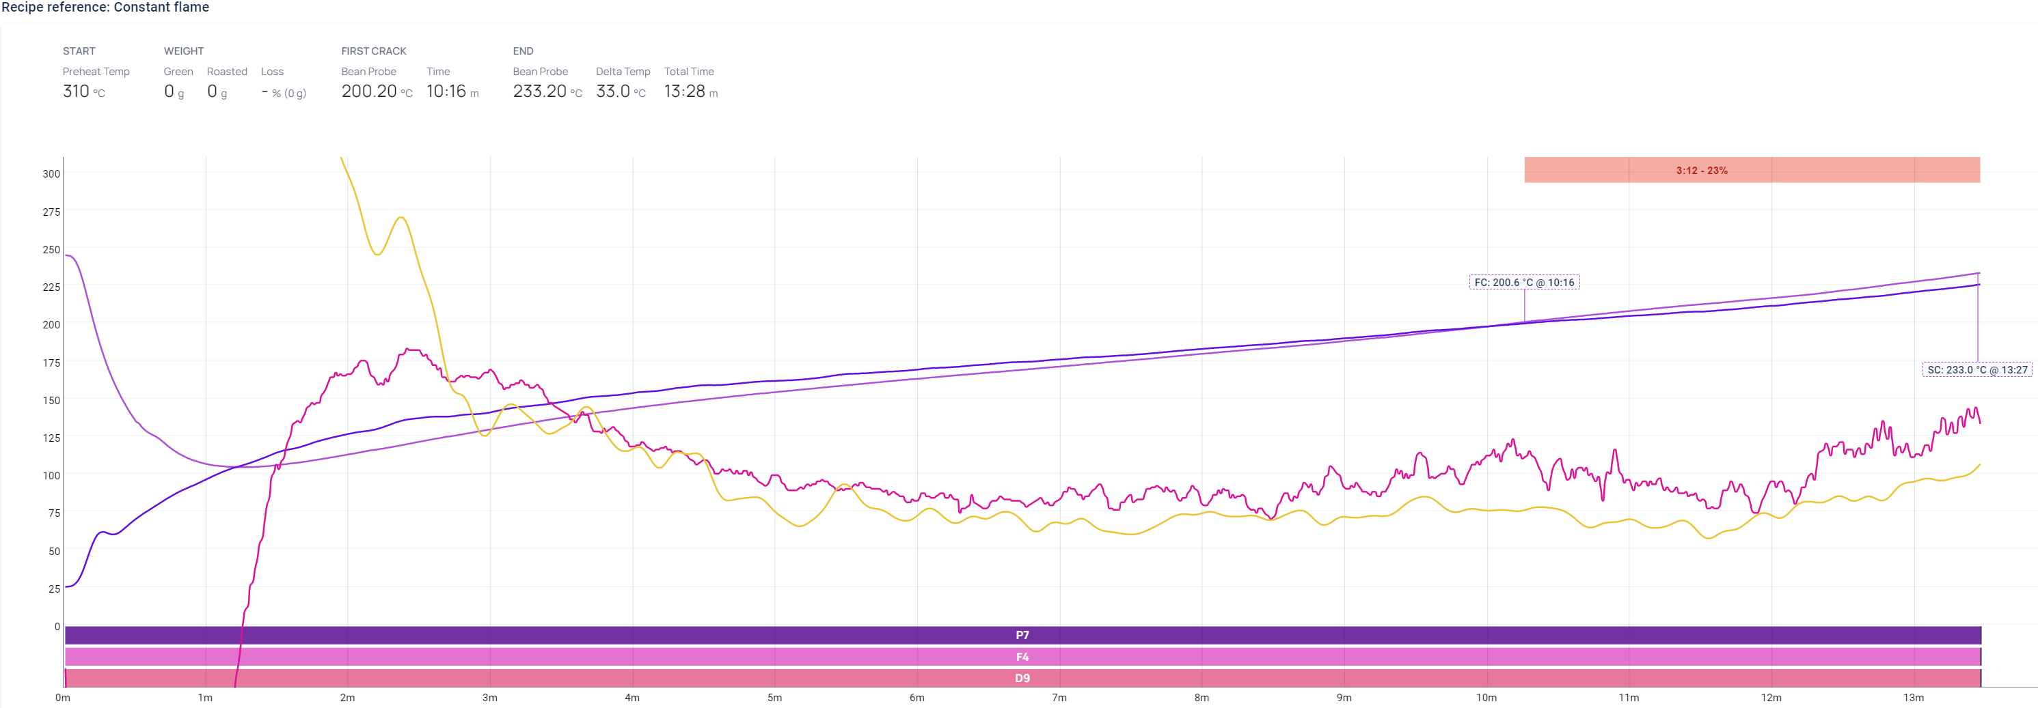
Bean probe
and
Infrared temp measurement
with constant ‘flame’
IKAWA with constant air-temp in ‘Inlet profile’ roasting mode
Which of the above Rate of Rise curves should be smoothened and why?

Slide 20
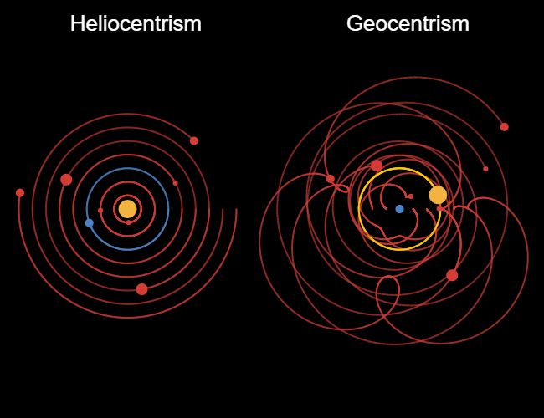
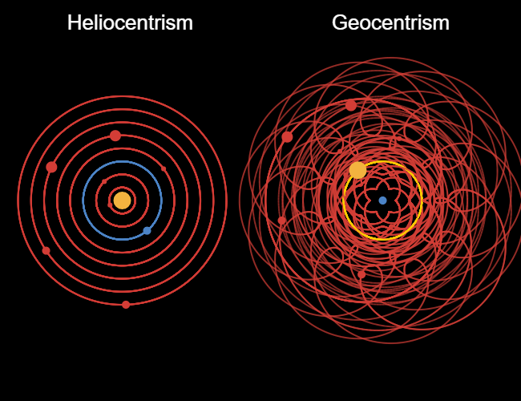
How does a good theory look like?

Slide 21
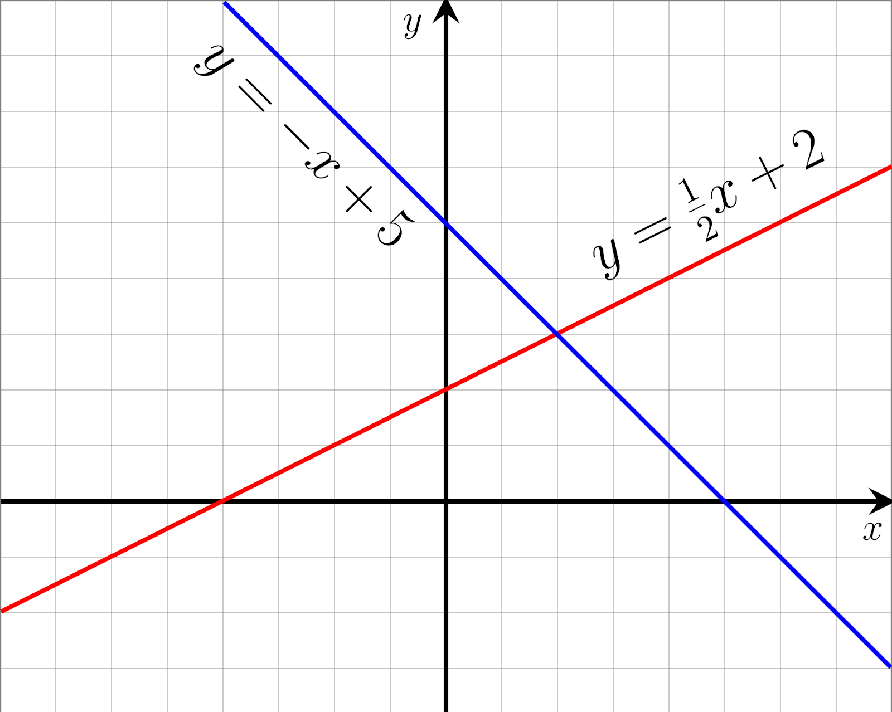
How does a good theory look like?
Cause | → | Effect
Input | → | Output
Independent variable | → | Dependent variable
RoR shape as Independent variable?
Temp probe is artifact and confounding burdened already and more like a relative reading of how far are we from
1st crack
Target temp
Color intensity?
What is predicted for the Dependent variable?
What is specifically predicted?
‘Baked’ is a categorical variable that is only relevant with big differences.
Does it become more or less acidic? More or less bitter?
What well established physical/chemical theory is expected to be the mechanism between input and output?
Kinetics and Ideal gas law
Both Independent and Dependent parameter should be carefully chosen amongst simplest possible and most specific concepts with the fewest assumptions otherwise it’s difficult to be specific and therefore practical in the use of the theory
Temperature, Time, Color Intensity, Basic tastes and Flavour categories. NOT Derived values nor Preference claims
In an experiment you have to keep
everything else equal
but the one parameter you investigate. You can’t keep both Dev and Col constant when experimenting with constant vs non-constant RoR

Slide 22
Small things does not become bigger in reality just because you magnify it

Slide 23
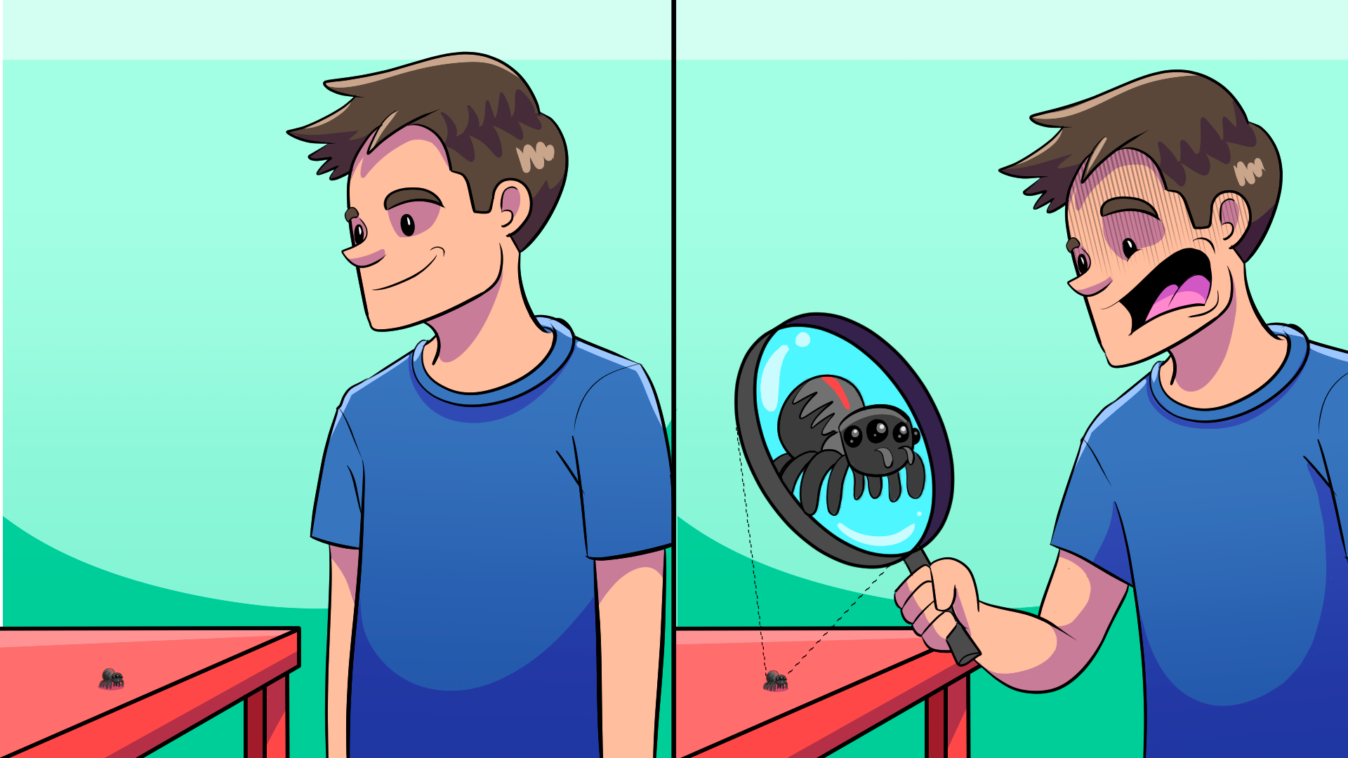
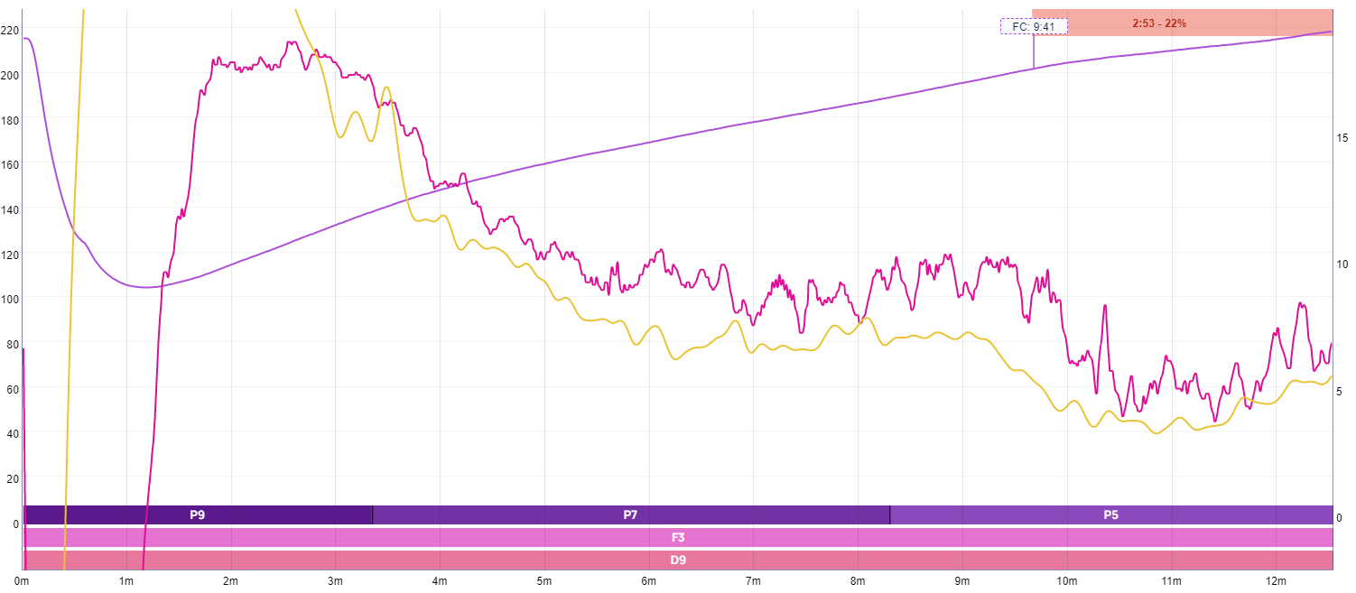
Focus on aspects of roasting which are too small to be sensory relevant
Focus on micro fluctuations (RoR Flicks)
No specific preditions other than ‘nicer’ (RoR smooth + DTR)
Focus on macro paramters
Specific predicted flavour INTENSITIES
Color = 80%
Development time 15%
Total prediction = 95%
Saves PREFERENCES analysis for later!

Slide 24
Parameter priority
Other: Drum Speed
Air flow
Heat source
5
4
Timing:
Time to 1stCr
3
Timing:
Development time
2
Input: Flame plan
Output: Color
1
Green coffee
Flavour, Quality, Price

Slide 25
The goal is to obtain the following objectives Reduction points are triggered by bean temp

Slide 26
1) Full flame to 2nd crack
2) Find first reduction point
3) Find second reduction point
No flame micromanagement nor improvisation
Too late anyway
”Roast Profile Design Basics”
E-learning Normally €30
Part of offer bundle later

Slide 27
All roasters

